Slide 1

Mitigating Hotel Revenue Management System Risk Using Anomaly Detection in Short Booking Windows
MWDSI – April 9, 2022

Slide 2





Team
Rishabh
Sharma
Pratyusha
Gajavalli
Surya
Sathiyamurthy
Evan
Tiffany
Pranoy
Bhattacharya

Slide 3






Business Problem
Issues Today
Solution
Low visibility in changing demand
Monitor the demand in real-time
Affected price mark-up; reduced revenue optimization
Build an alert mechanism in real-time anomalies in demand
Noncompetitive pricing increases the likelihood of booking a competitor's properaty
Utilization by property managers in decisions of price for the property
Notes:
Issues today:
Low visibility in changing demand of a property real time
This affects the price mark-up that can happen on the property, that can help in increasing revenue as demand is high
In cases of low demand, the price can be dropped to increase the likelihood of booking at a competitor's property
Solution should consist:
To monitor the demand in real time and how it compares to the forecast
Build an alert mechanism that finds that generates alerts in real time about unexpected increase/ decrease in demand
This alert needs to be generated on each property individually
If possible, segregate the alerts into high, medium and low based on severity

Slide 4





Business Benefits
Real-time Alerts in Demand Change
Price Optimization
Increase in Revenue
Deep-dive Into Changes in Demand
Advance Planning of Resources

Slide 5
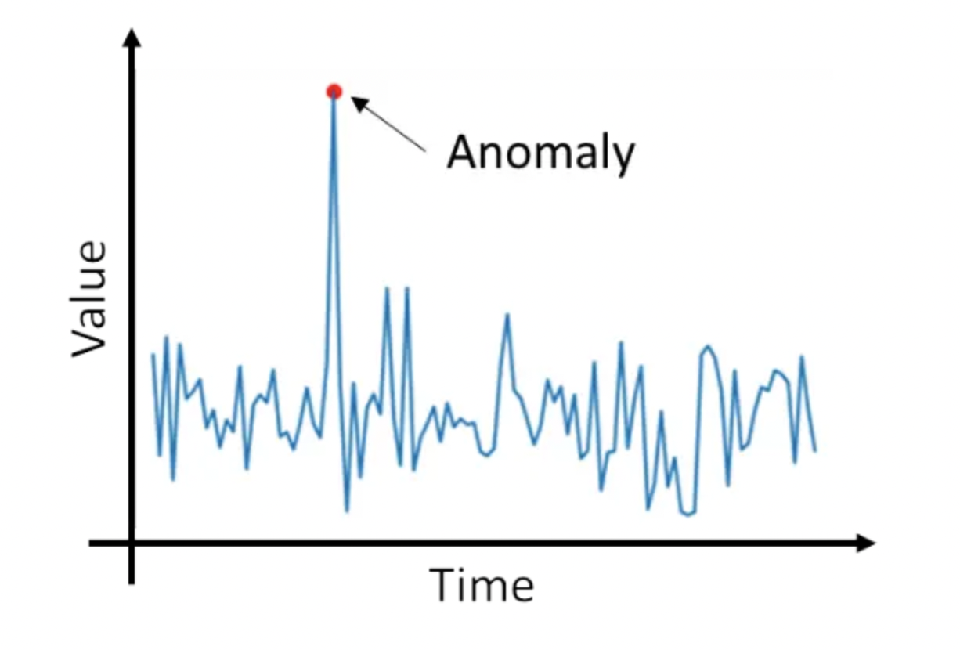
Business to Analytics Problem Framing
Collect Data
EDA
Pre-processing
Anomaly Detection Models
Revenue Optimization
Alert Generation
Model Comparison
Image Source : https://www.analyticsvidhya.com/blog/2021/08/univariate-time-series-anomaly-detection-using-arima-model/
Notes:
Collect the data and all individual data segments, like acquisition channel, details and features about properties, location and historical bookings
Perform EDA to remove anomalies, filter/ replace missing data
Literature review on best practices for anomaly detection in time series
Shortlisting the best algorithm forward by comparing results among all of them
Implementation and testing of framework and algorithm developed
Synthesis results and discuss with business
Alert generation via email and report for it
Improving the results and anomaly classification

Slide 6







Methodology Workflow
Data Preprocessing
Anomaly Detection
Alert System
Data from past 3 years - 2019 to 2021
Training Data
Feature Creation
Cluster-based
Anomaly in Booking
Property code, stay date, nights, 24-hour lag, 48-hour lag
Detection of anomaly and classification of its type
PCA
Best Model / Algorithm
Report Generation
Data
Data Cleaning
EDA
Standard Deviation
Details like anomaly date, # of bookings, anomaly type, past bookings
Best algorithm depends on property type (Shorter Stay Properties/Extended Stay Properties)
Alert to Revenue Managers
Other Algorithms
Validation of other properties
Test Data
Alerts sent to revenue managers with their names and email ids
Other algorithms tried are Isolation Forest, Angle based Outlier Detection, KNN, Connectivity based, Histogram based, Local Outlier Factor, One-class SVM, Minimum Covariance Determinant, Subspace Outlier Detection, Stochastic Outlier Detection

Slide 7
Anomaly Detection Models
Model | Principal Component Analysis | Standard Deviation | Clustering-based
Pros | Preventative measure for sporadic anomalies | Basic, easily interpreted model | Easily visualized and interpretable
Cons | Anomalies on the low end were easily missed | Skewed data causes issues with anomaly prediction, over predicting on the heavy tail | Clusters may include true anomalous points
Based on literature review and different use cases, other anomaly detection models have lower accuracy

Slide 8
Property Comparison
Property Type 1
Property Type 2
Airport Stays
Shorter length Stays
Hometown Studios
Extended stay guests and rooms include amenities like kitchenettes for long-term guests.

Slide 9
Anomaly Detection for Shorter Stay Properties

Slide 10
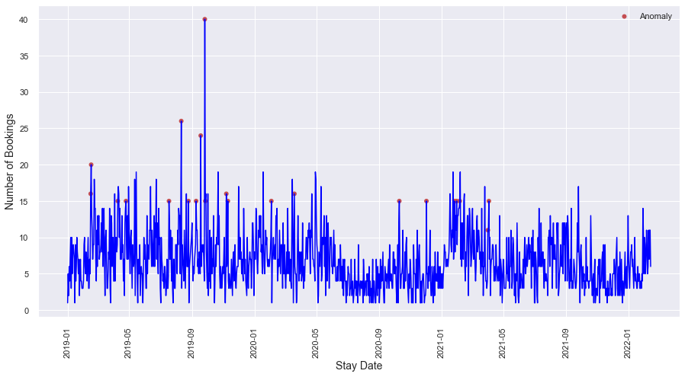

Model Comparison and Selection
Cluster based Detection
PCA
Clustering-based models can identify anomalies more accurately than PCA based models

Slide 11
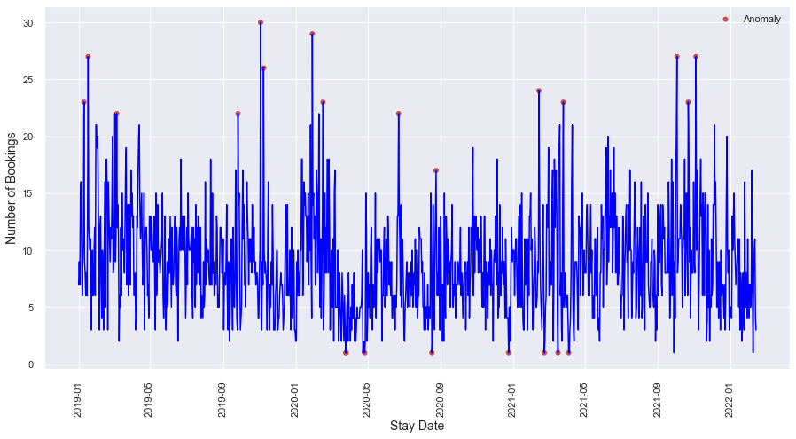
Scope of Improvements in Current Solution
Algorithm Selection:
Clustering Based Anomaly Detection
Rule Selection:
Points >= 3 Std.dev above mean is an anomaly
Remove points < 3 Std.dev below mean
Improvements aimed to:
Make sure that no anomaly goes undetected
Remove false positives

Slide 12

Implementation of Model and Rule-based Anomaly Detection
Before
After
TPR: 100%
Clustering-based + Rule-based model identifies more anomalies than Clustering-based model alone

Slide 13
Anomaly Detection for Extended Stay Properties

Slide 14
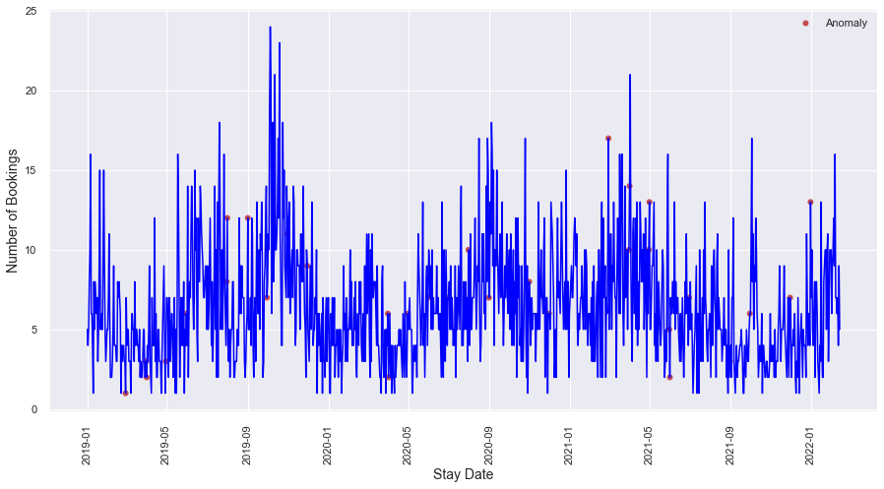

Model Comparison and Selection
PCA
Clustering Based
Combination of Cluster and PCA based detection identifies anomalies more accurately on Extended Stay Properties Properties

Slide 15
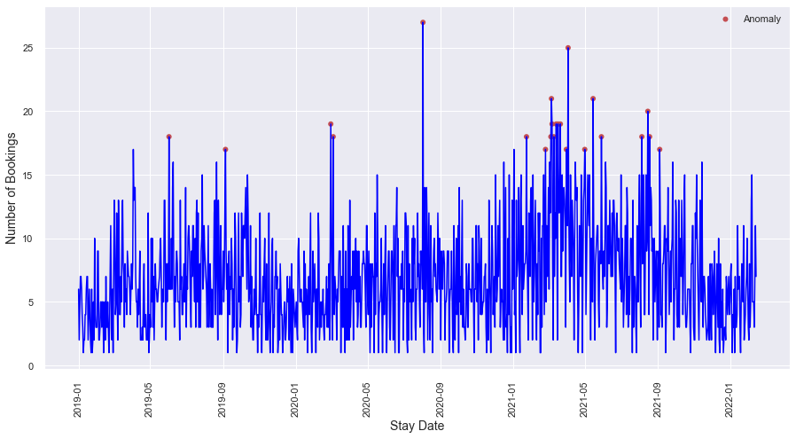
Scope of Improvements in Current Solution
Algorithm Selection:
Combination of Clustering & PCA
Rule Selection:
Remove points < 3 Std.dev below mean
Points >= 3 Std.dev above mean is an anomaly
Improvements aimed to:
Make sure that no anomaly goes undetected
Remove false positives

Slide 16
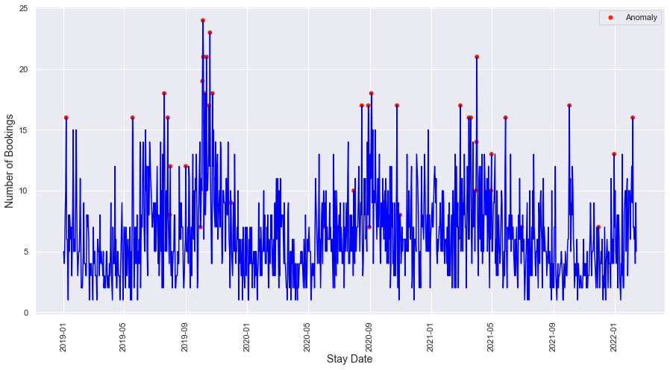
Implementation of Model and Rule-based Anomaly Detection
Before
After
TPR: 100%
Clustering-based + PCA + Rule-based model identifies more anomalies than
Clustering-based + PCA model alone

Slide 17
Approach Summarization
All Properties
Shorter Stay Properties Properties
Extended Stay Properties Properties
Algorithm Selection:
Clustering Based Anomaly Detection
Algorithm Selection:
Combination of Clustering & PCA
Rule Selection:
Points >= 3 Std.dev above mean is an anomaly
Remove points < 3 Std.dev below mean
Rule Selection:
Points >= 3 Std.dev above mean is an anomaly
Remove points < 3 Std.dev below mean

Slide 18
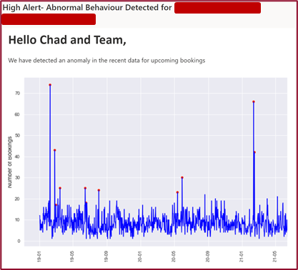
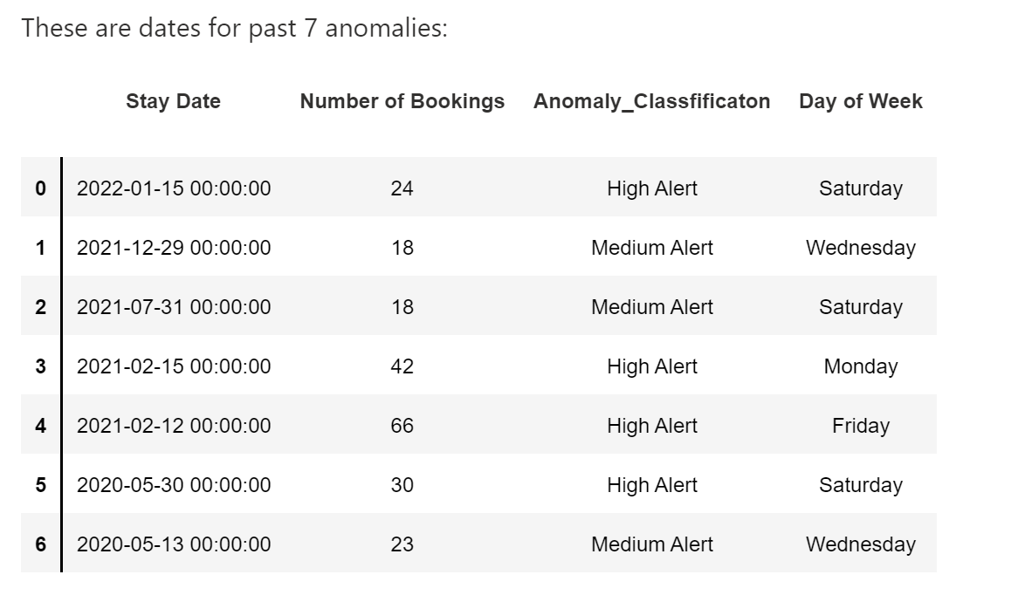
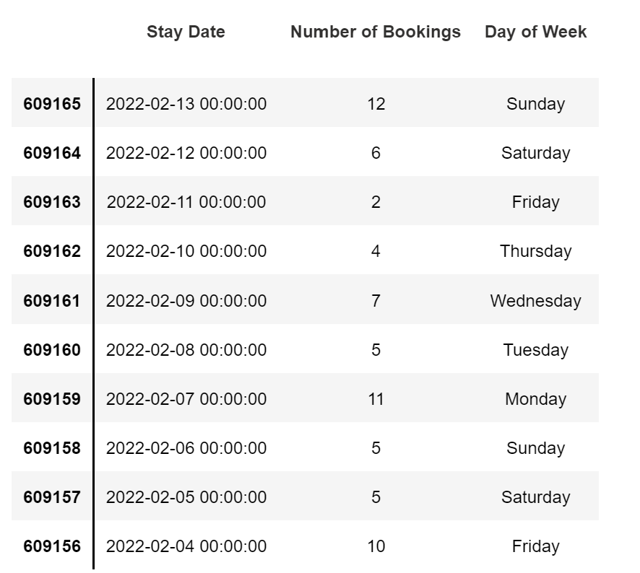
Alert System and Anomaly Types
Anomaly Classification
Anomaly Detected is
In the alert, a time series printout will be provided highlighting anomalous data.
Additionally, the alert will highlight previous recent anomalies.
Finally, those included in the email will see the number of bookings for the future days to help prioritize high booking dates.
High
> 3 Std.dev away
Medium
2 - 3 Std.dev away
Low
1 - 2 Std.dev away
Fig: 1- Snapshot of email with team members, type of alert and time series
Fig: 2- Snapshot of past 7 anomalies, type of alerts, dates and day of the week
Fig: 3- Snapshot of booking details of the past 45 days, # of bookings

Slide 19
Model Assessment
Property Count | Total Data points | Actual Positives | Actual Negatives (Total - Actual + ve) | Detected Positives | True Positive (TP) | False Positive (FP)
11 | 10,522 | 175 | 10,347 | 238 | 146 | 92
~83%
~1%
True Positive Rate =
True Positives (TP) / Actual Positives
False Positive Rate =
False Positives (FP) / Actual Negatives
True Positive Rate is the rate at which data points that are actual anomalies are correctly identified as anomalies by the algorithm/model
False Positive Rate is the rate at which data points that are NOT actual anomalies are incorrectly identified as anomalies by the algorithm/model
* Data used is unlabeled data, values seen above are approximate values and not accurate values. It is not possible to calculate accuracy for an unlabeled data set
Detailed numbers can be found in appendix

Slide 20



Recommendations
Operations Management
Staffing Adjustments based on demand
Inventory management
Plan property capacity better, based on demand
Pricing Optimization
Adjust pricing based on demand

Slide 21

Business Impact
> 80 K
+ 2.6 to 3.5%
Total Bookings from >10 K days
Overall increase in revenue over
total bookings
+ 34% to 46%
~ 6 K / 7%
Increase in Revenue for specific days in which anomalies are detected
Total Bookings from ~150 days that are anomalies based on the model / algorithm
Alerts are triggered after at least 25% of the bookings have happened
% change in price used for calculations for High Alert - 50%, Medium Alert - 35%, Low Alert - 20%
Detailed calculation can be found in appendix

Slide 22




Evan
Future Scope
Test on a pilot basis and compare performance
Anomaly detection on a broader timeline
Strategic dynamic pricing for the detected anomalies to optimize revenue
Implementation within the organization to maximize the revenue benefit of this product
Notes:
Implementation within the organization to show the revenue benefit of this product
Strategic pricing for the detected anomalies to optimize revenue
Anomaly detection on a broader timeline

Slide 23


Mentors
Matthew A. Lanham
Kirstin Dolick

Slide 24
Appendix - Profit Calculation

Slide 25
Profit Calculation:
Total # of bookings | Actual Revenue | Actual Revenue for Total bookings
80288 | 100% | 8028800
Alert Type | # of Bookings | Actual Revenue | Increased Revenue
High | 4615 | 100% | 50%
Medium | 1288 | 100% | 35%
Low | 69 | 100% | 20%
Total # of bookings in anomaly days | 5972 | 597200 | 277210
% of bookings that are made in anomaly days = (5972 / 80,288) | 7.44%
Increased Revenue in days in which anomalies are detected = (277,210 / 597,200) | 46.42%
Overall Increase in Revenue = (277,210 / 8,028,800) | 3.45%

